Slide 1
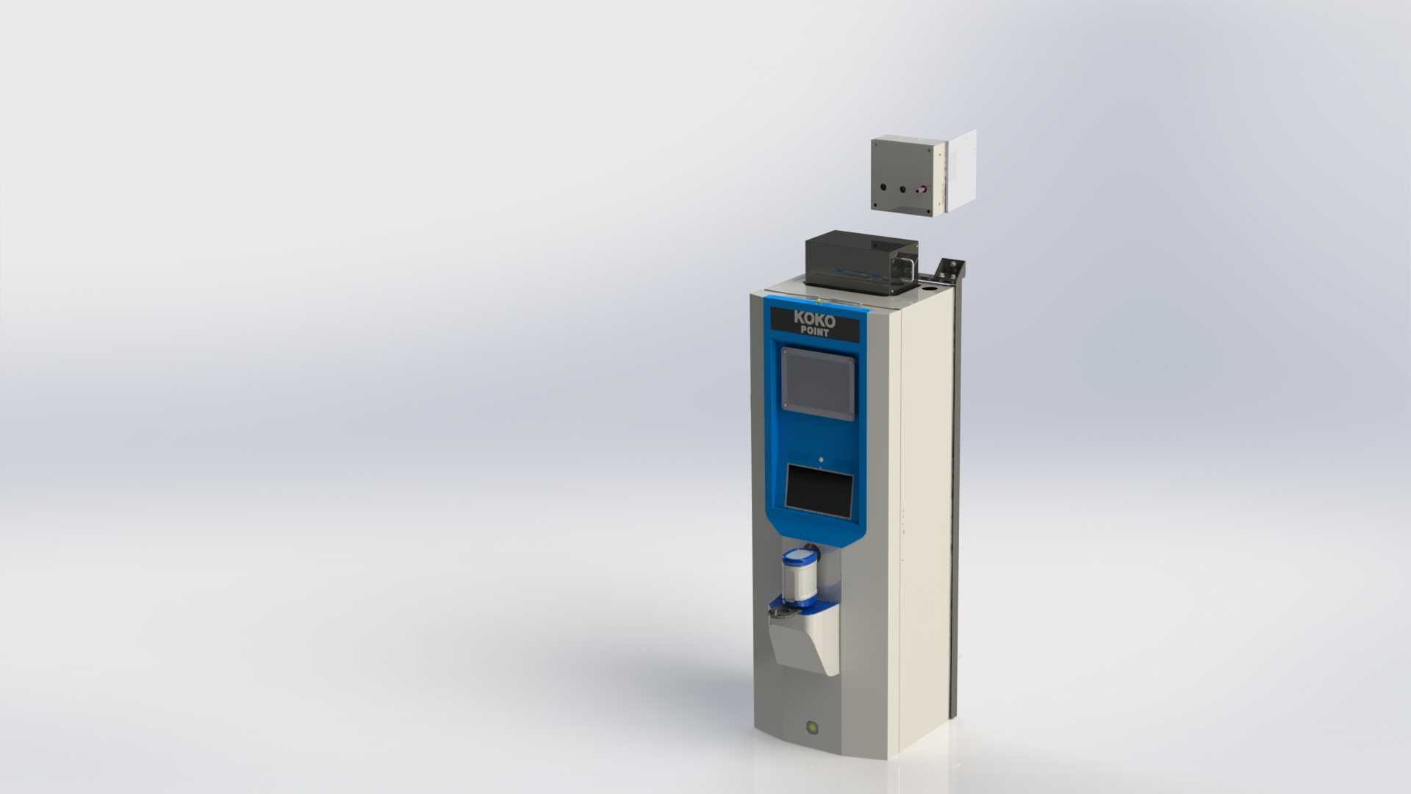
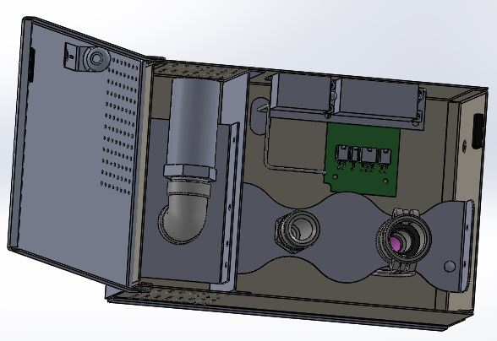
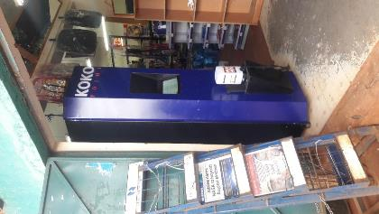
KOKOpoint Components Setup

Slide 2
Objectives
Objectives
The purpose of this presentation is to enable trainees understand:
The tools required to prepare the various components pre-assembly
The setup methodology

Slide 3
Contents
Areas to be covered
High level setup(Tablet and Modem)
Cable preparation and molex layout

Slide 4
Setup Methodology
Methodology defined in this presentation will cover;
Device Configuration
Cable crimping
Others as may be applicable

Slide 5
Tablet Configuration
Tools/Equipment
PC(with adb installed)
Mini-USB cable
Process
Create tablet account(for access to media drives)
Install firewall (AFWall+)
Install latest version of KOKO launcher and app
Give firewall permissions to the 2 KOKO softwares plus download manager and google services
Set local timezone
Disable default keyboard
Disable notification sounds
Disable device rotation
Get device unique ID

Slide 6
Modem Configuration
Tools/Equipment
PC
Ethernet cable
Process
Log in to teltonika website(192.168.1.1)
Update modem password
Update timezone to local
Set mobile ISP for both SIM 1 and 2 as well as their respective APNs
Set SMS utilities for remote;
rebooting
status query
SIM switch through both NOC phone or shortcode

Slide 7
KPC Configuration
Tools/Equipment
PC(with arduino IDE and KPC firmware libraries installed)
USB A-B cable
Process

Slide 8
UPS setup
Tools
Star screwdriver
Process
Turn the UPS potentiometer anti-clockwise till the it rests on the stopper
This should set the UPS output voltage to >=14V when on mains.

Slide 9
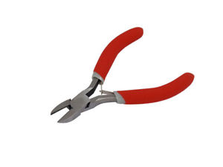
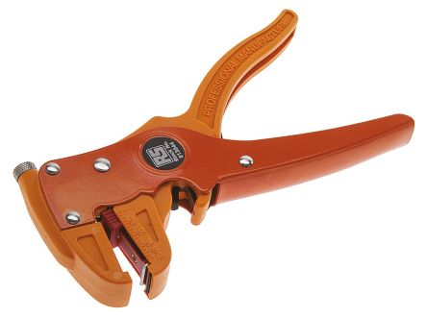
Contents
Cable set-up tools
The tools needed to set up component power cables are as listed
Side cutter
Wire stripper
Crimping tool(see you later!!)
Cable stripper
Side cutter

Slide 10
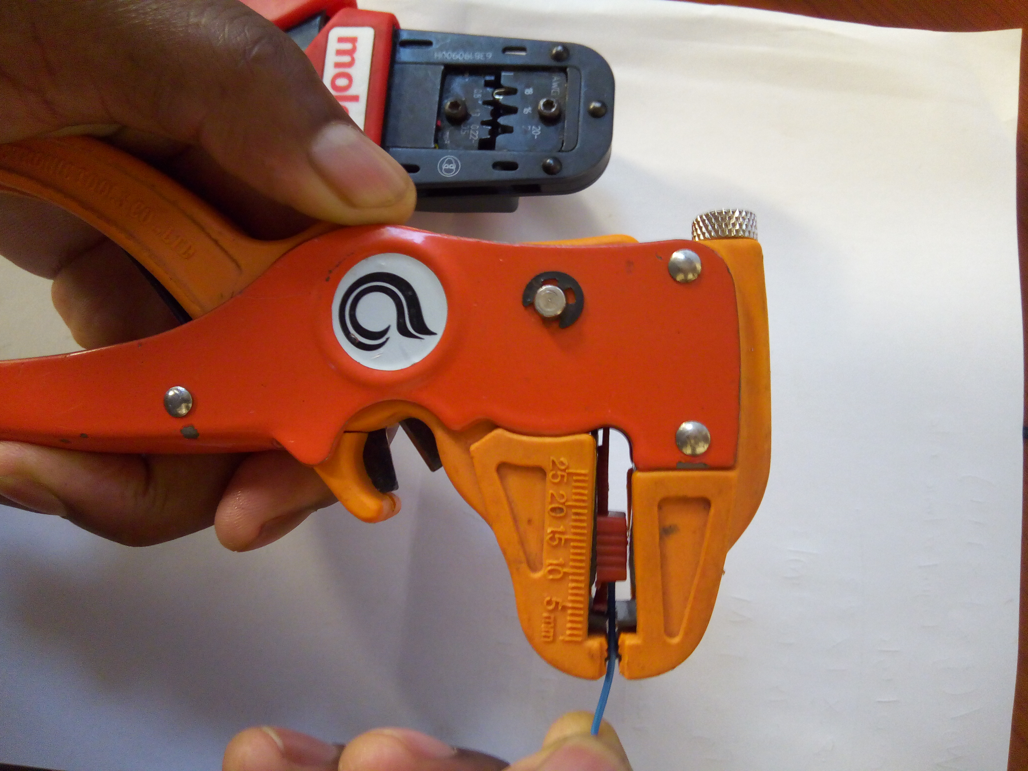
Contents
Stripping a cable
Adjust this part for double insulated cable
Size of strip determined by number of insulation layers
Place cable in stripper and tip must touch stripper length guide
Squeeze stripper and release to strip
For very thick cables,use scalpel or side cutter
Default 8mm

Slide 11
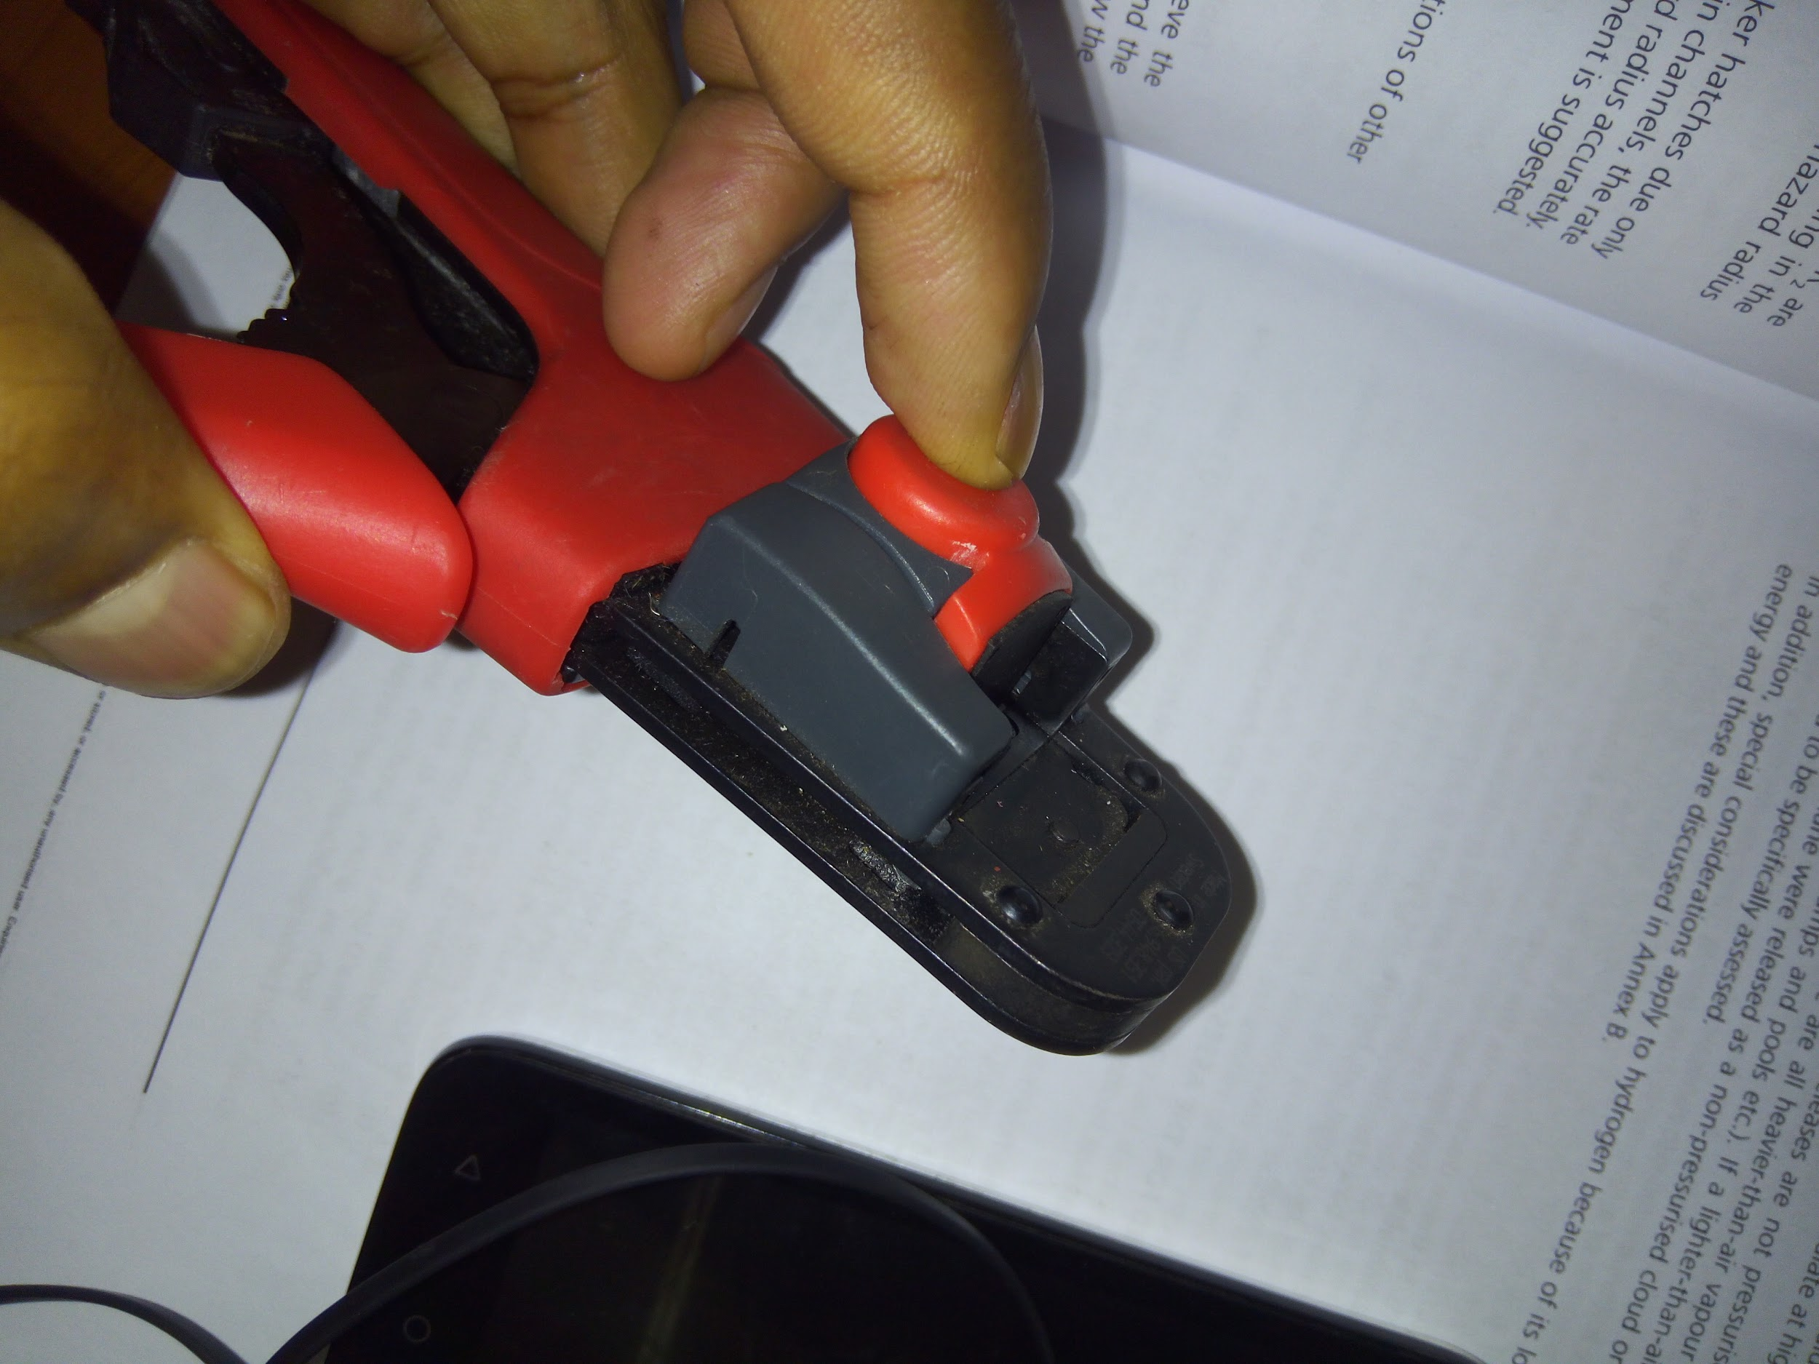
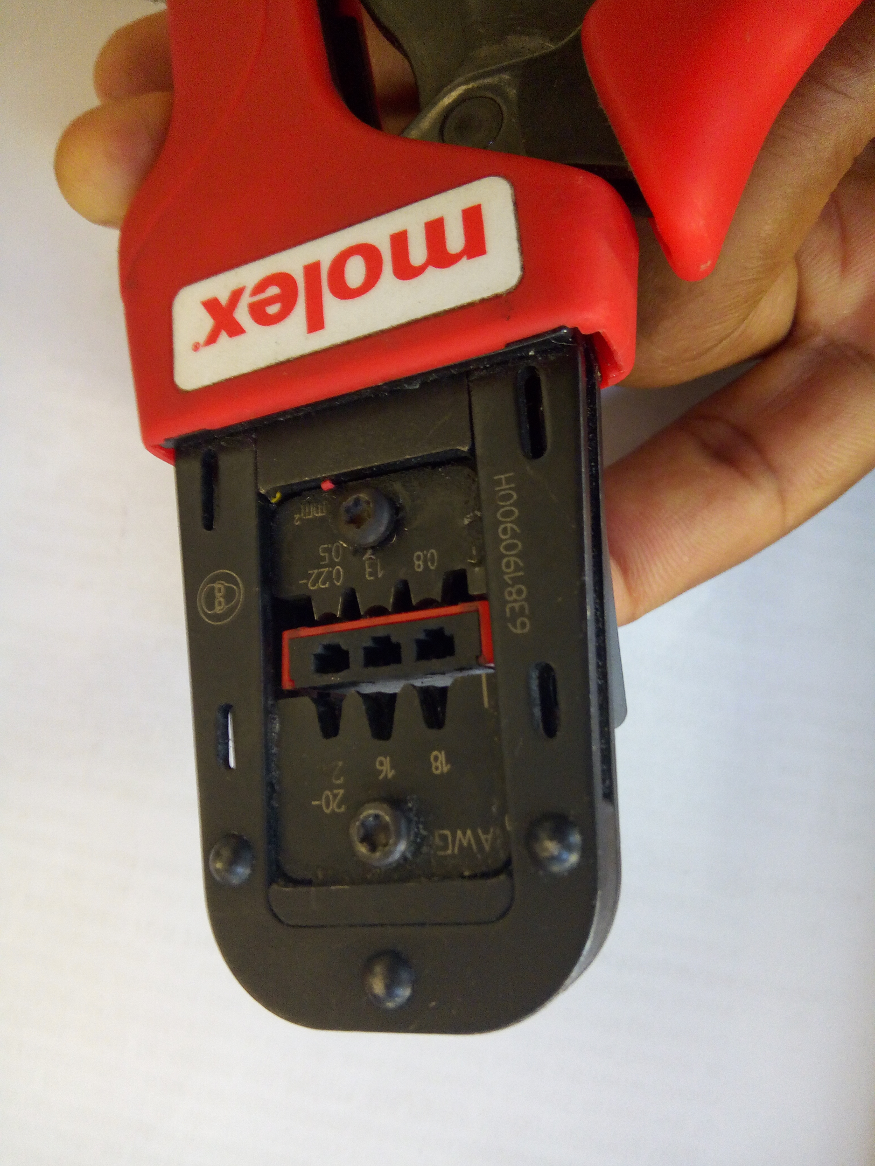
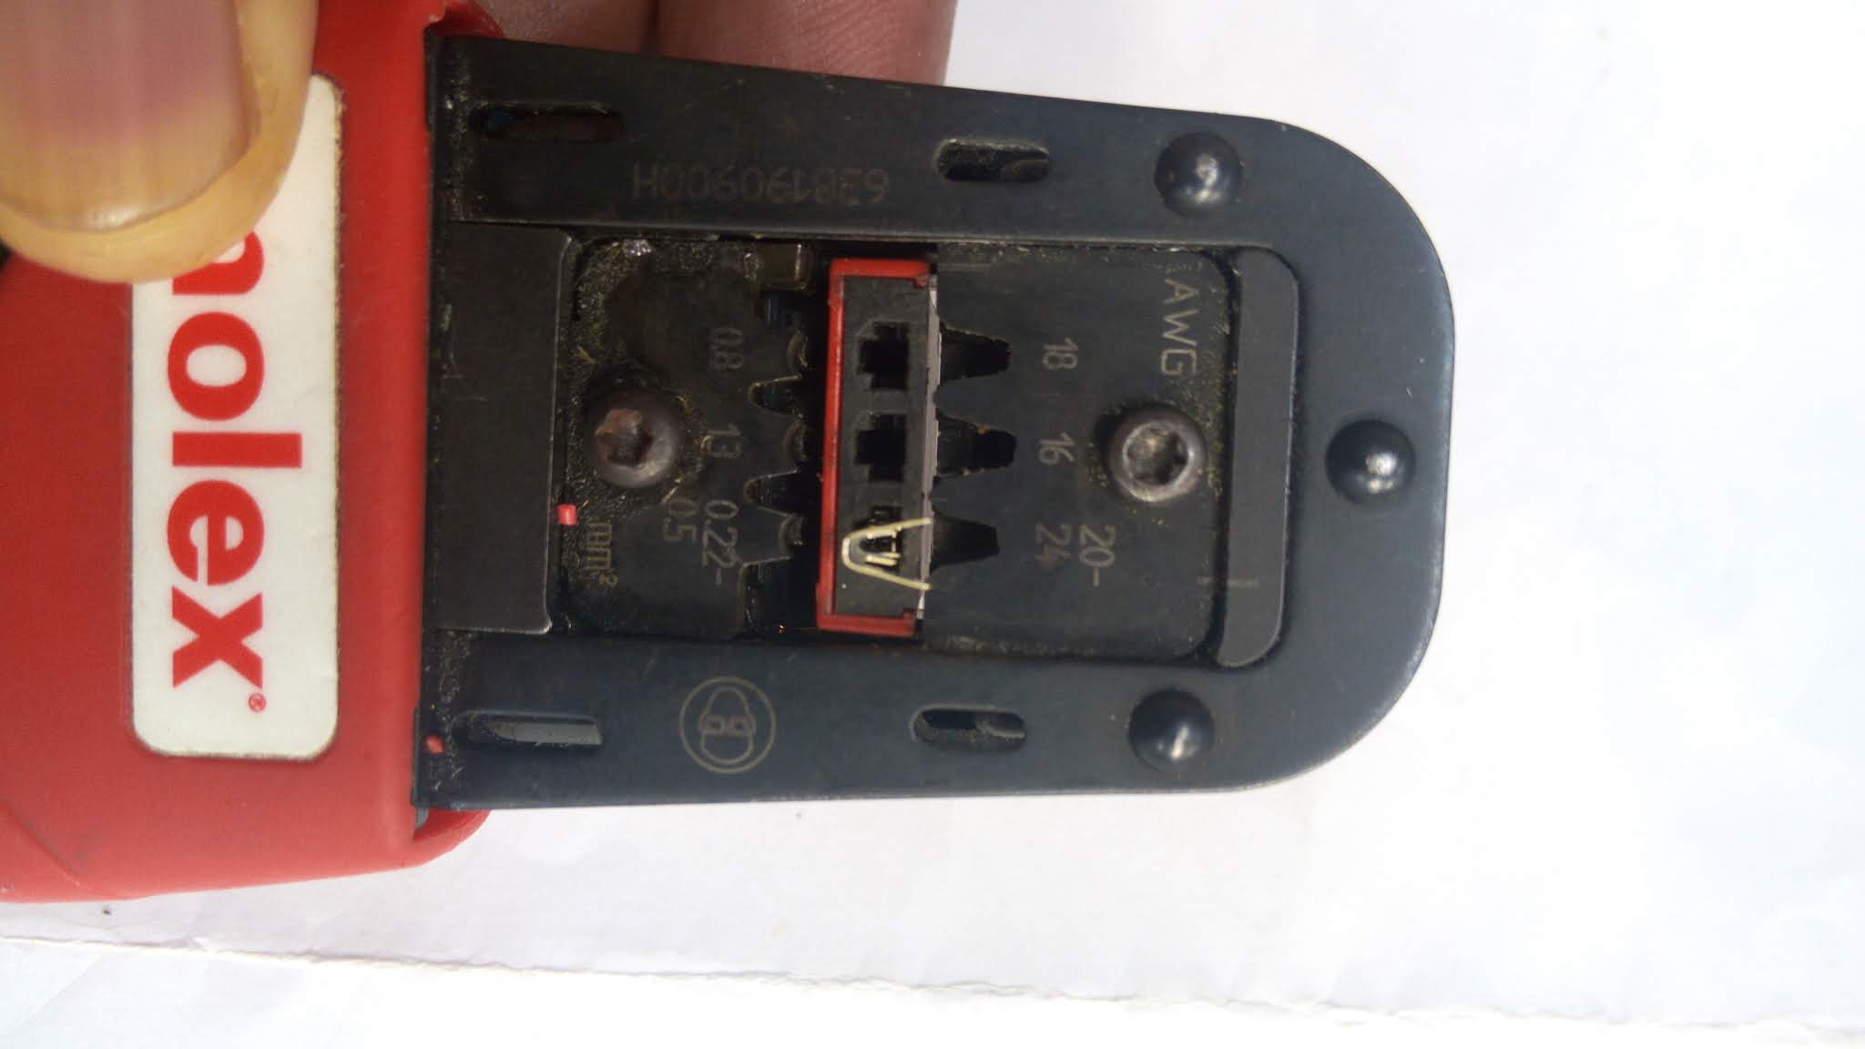
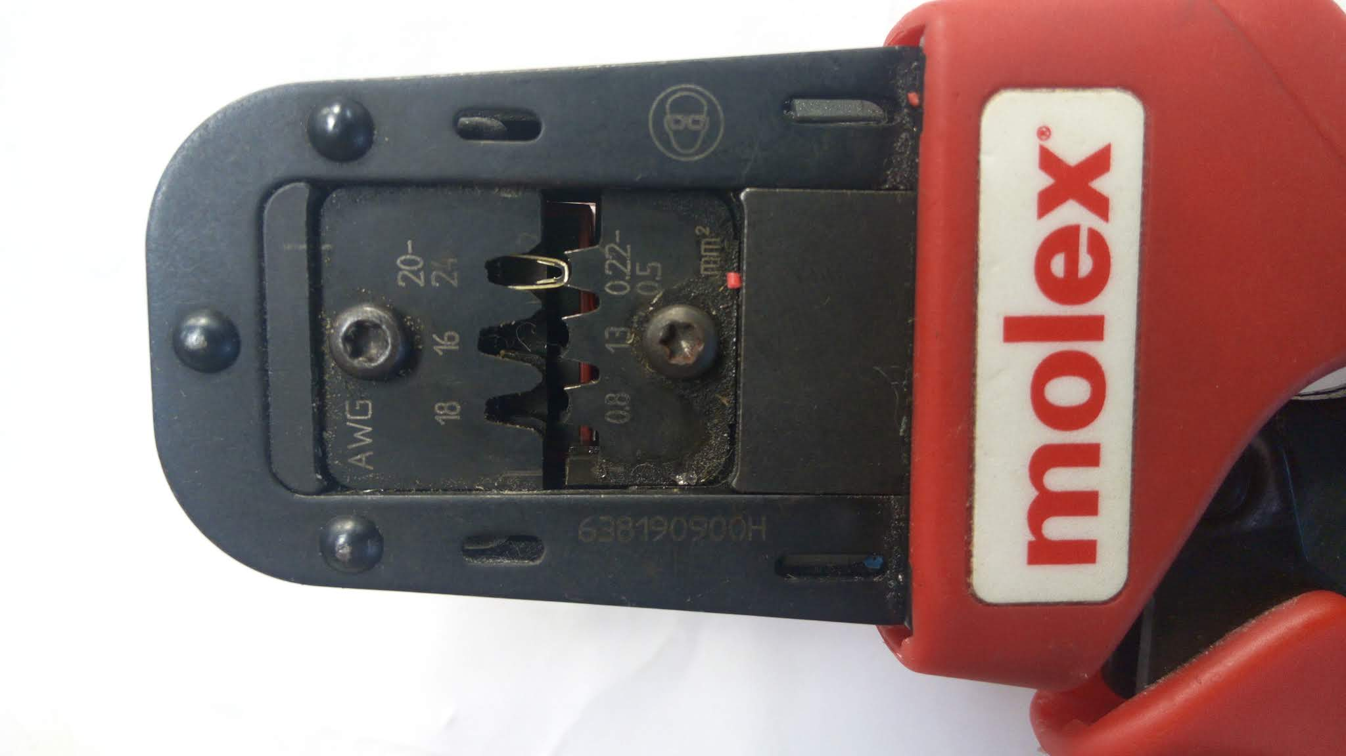
Contents
Crimping a cable
Press to level up pin holder
Insert pin to correct AWG
Release and gently squeeze the tool till first click to lock pin in position
Tightly press arms fully to crimp cable
1.Press
2.Level up
3.Insert pin
4.Squeeze

Slide 12
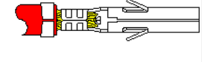
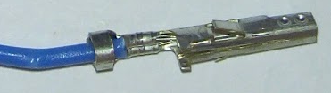
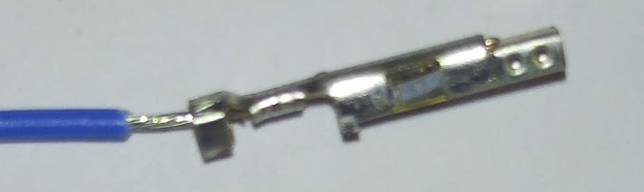
Crimp Quality
Comparison of benchmark, good and bad crimp.
Benchmark
Good crimp
Cable insulation not held by pin
Bad crimp

Slide 13
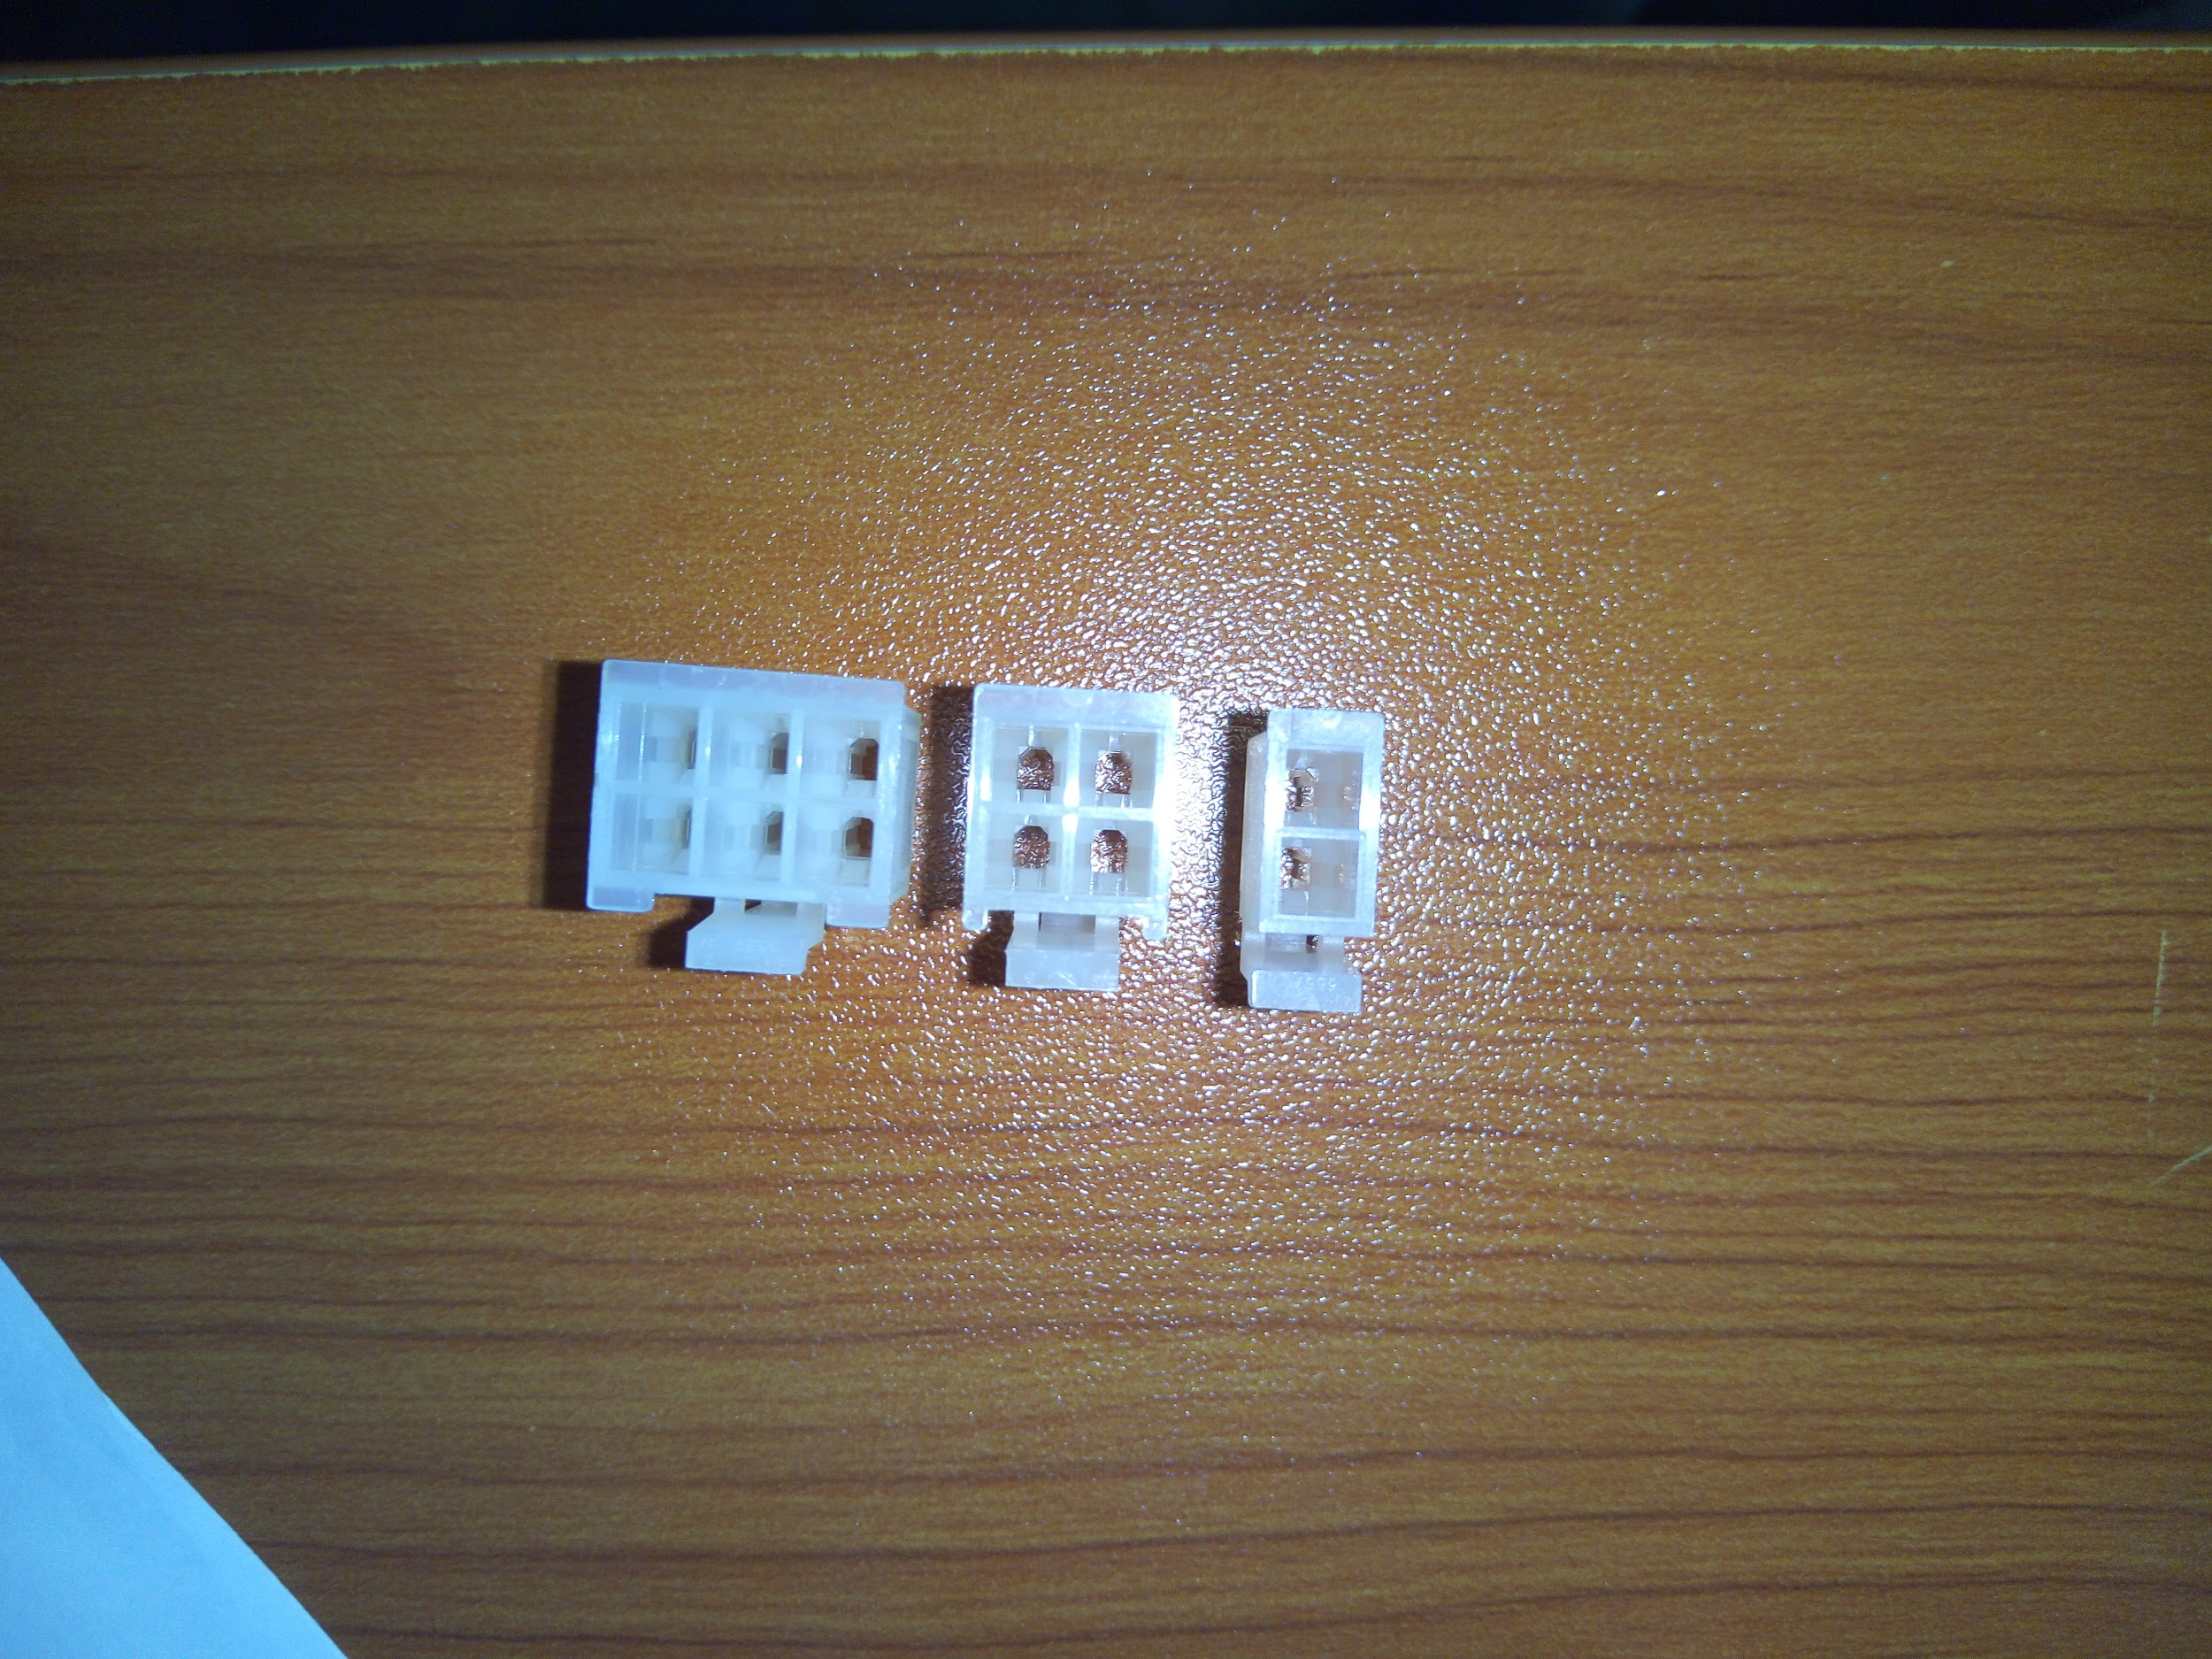
Fitting crimped Cable to Molex connector
3 different Molex connector types are used across the KP depending on power and signal lines.
These are:
Note the slot numbering. 1 consistently used for 12V/5V lines of the components.
2x2 connector(4-pole)
2x1 connector(2-pole)
2x3 connector(6-pole)
2
4
3
6
5
4
1
2
3
1
2
1

Slide 14
Component Setup
Components are listed per associated minifit connectors as below:
2-pole
Canister dock switch
Reset switch
4-pole
Solenoid valve
Illuminated Signage
Fan
Pump
Flowmeter
Ethanol sensor
PIR
Door latch
Door sensor
Tank pressure sensor
Canister full sensor
Tank temperature sensor
6-pole
Motorized ball valve
Calibration module
Refill box cable(2 ends)

Slide 15
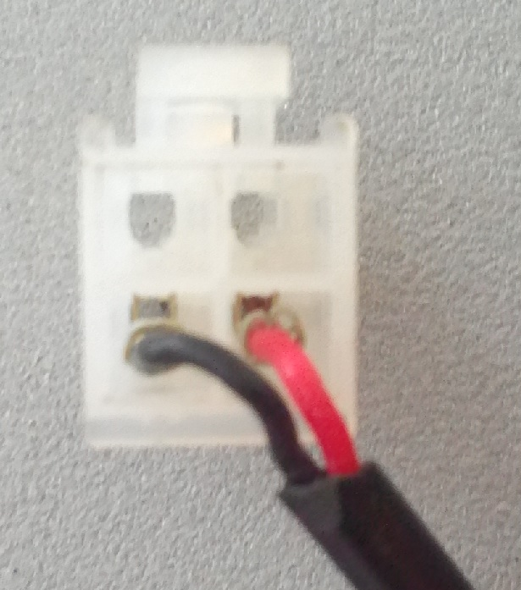
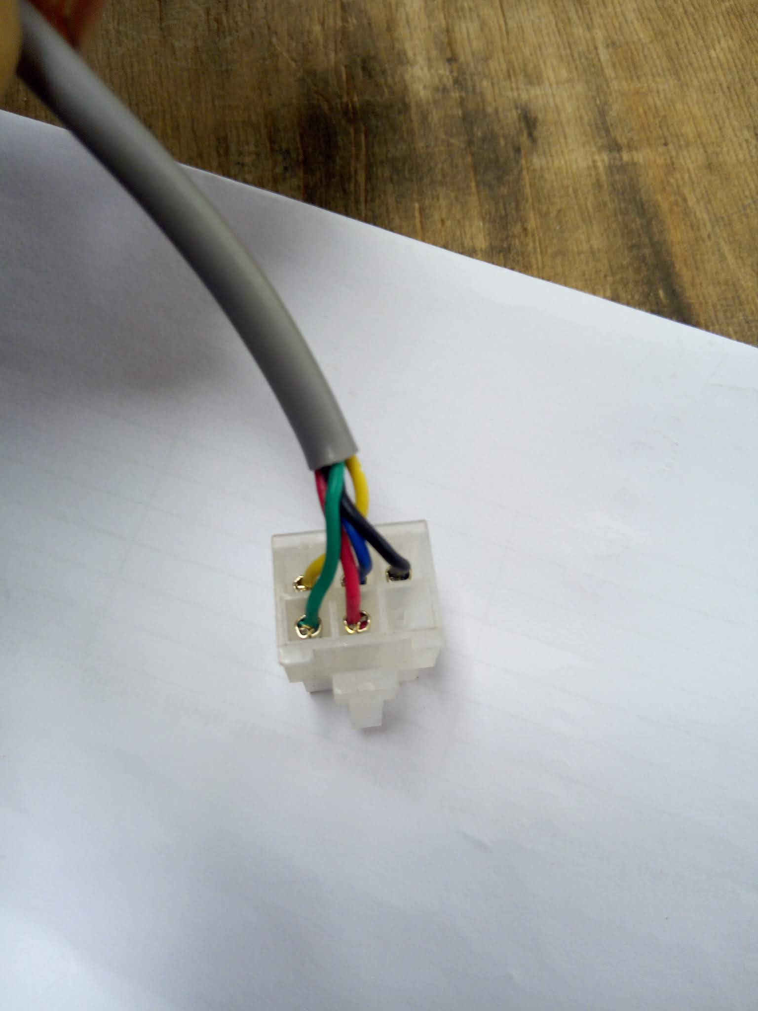
Sample Component Molex Setups
Pin configuration:
1-12V
2 - GND
1- Yellow
2 -Blue
3 -Black
4 -Green
5 -Red
6 -Unused

Slide 16
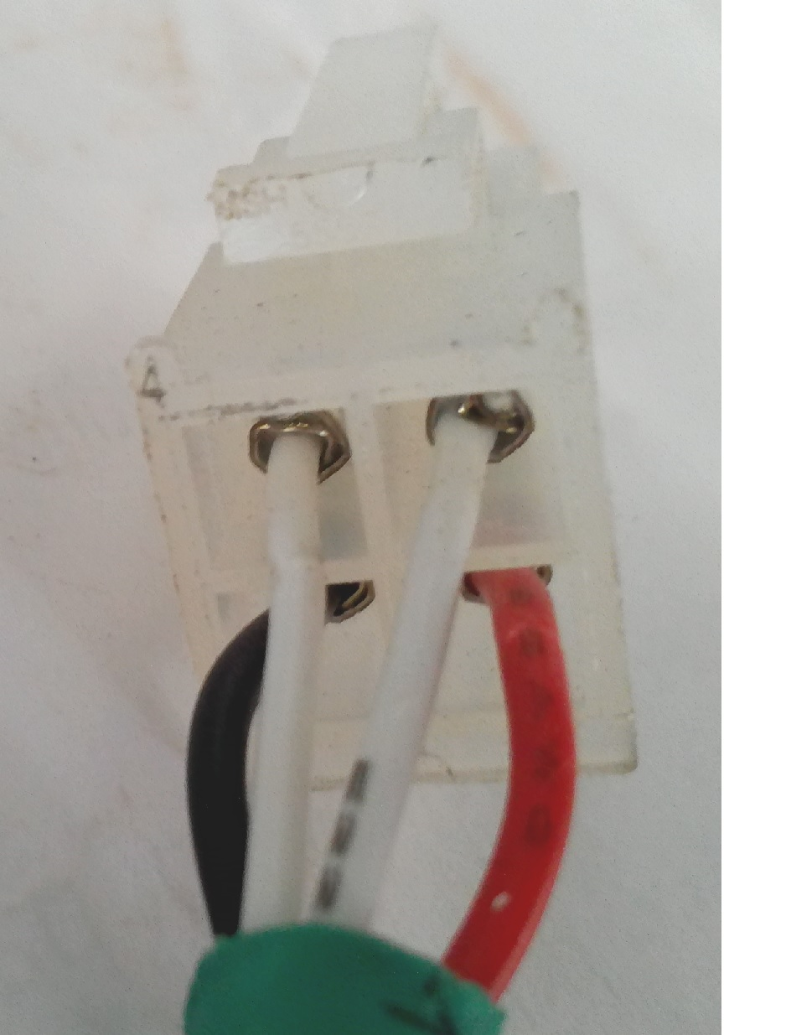
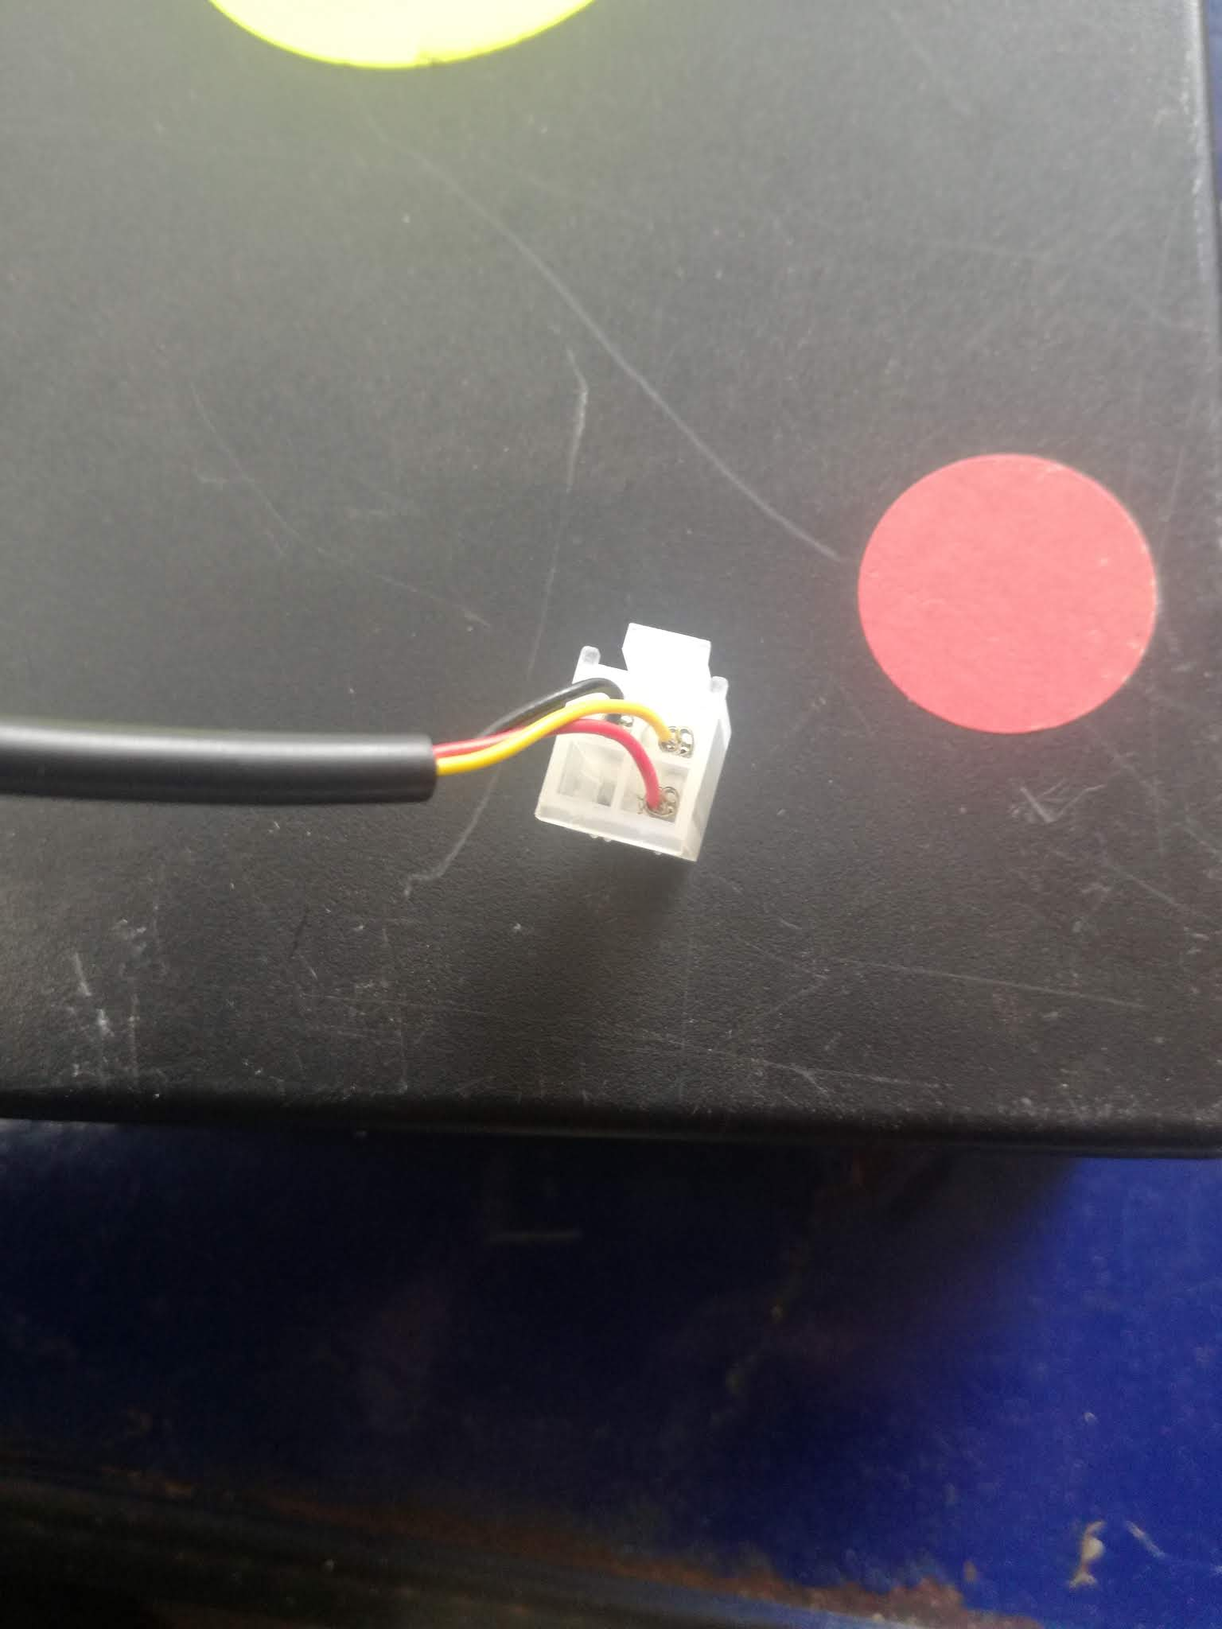
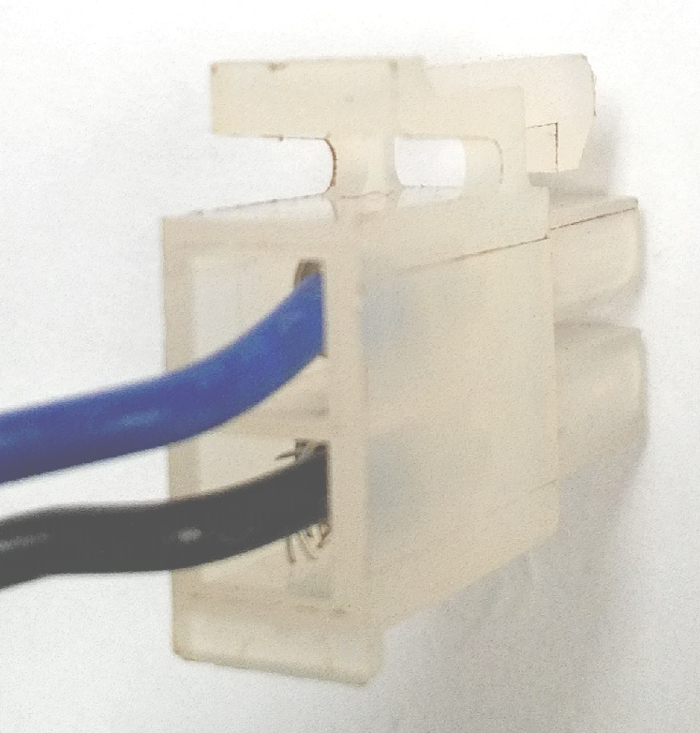
Sample Component Molex Setups
Pin Configuration;
Red(12V)
Black(GND)
White(5V)
White(SIG)
Pin Configuration
1-Red (12V)
2-Unused
3-Yellow (SIG)
4-Black (GND)
Pin configuration:
1- Blue(5V)
2 - Black(SIG)

Slide 17
Finally
Refer to the component wire colours in appendix of KP6c Component Setup Manual.
Refer to same document for more detailed outline of component setup.
For overall familiarity with the KP also go through the KP6 Descriptive Technical Manual.

